Slide 1
Analyzing Bird Strike Data Across US States Using SQL and Power BI
DEBASISH DEKA
DATE : 10/06/24

Slide 2
DESCRIPTION
This project focuses on analyzing bird strike data across various airports in the United States, utilizing SQL for data manipulation and Power BI for visualization. The dataset includes key attributes such as airport name, airline operator, origin state, number of birds struck, cost, bird species, sky condition, and aircraft model. The analysis aims to uncover patterns and trends in bird strike incidents, assess the financial impact on airlines and aircraft, and provide operational insights to enhance safety and efficiency. By leveraging SQL for thorough data preparation and Power BI for creating interactive dashboards, the project offers comprehensive insights into the frequency, cost, and conditions of bird strikes, helping stakeholders make informed decisions and improve risk management strategies.

Slide 3
KPI(KEY PERFORMANCE INDICATORS)
Total Cost of Bird Strikes: Measures the financial impact of bird strike incidents
Number of Bird Strike Incidents: Quantifies the overall frequency of occurrences.
Bird Strike Frequency: Tracks the rate of incidents over time or per flight
Injury Rate: Assesses the human impact and safety implications of bird strikes
Airline Involvement Breadth: Indicates the number of airlines affected by bird strikes.
Geographic Scope: Measures the spatial distribution of incidents across states.
Airport-Specific Incident Rates: Identifies high-risk airports for targeted interventions.
Aircraft Model Susceptibility: Highlights which aircraft types are most prone to bird strikes.
State-Level Incident Distribution: Shows geographical hotspots for bird strike occurrences.
Annual Incident Trends: Tracks year-over-year changes in bird strike frequency.
Sky Condition Impact: Analyzes how different weather conditions affect incident rates.
Aircraft Size Correlation: Examines the relationship between aircraft size and strike likelihood.
Altitude-Related Incident Distribution: Shows at which altitudes bird strikes most commonly occur.
Wildlife Warning Effectiveness: Assesses the impact of pilot warnings on incident prevention.
Airline-Specific Incident Rates: Compares bird strike frequencies across different airlines.
Flight Phase Risk Assessment: Identifies which stages of flight are most vulnerable to bird strikes.
Precipitation Impact on Incidents: Analyzes how various weather conditions affect bird strike rates.
Seasonal Incident Patterns: Tracks monthly variations in bird strike occurrences.
Cost by Aircraft Model: Measures the financial impact of bird strikes for specific aircraft types.
Altitude Range Risk Profile: Provides a detailed breakdown of incident likelihood at various altitudes.

Slide 4
TOP 3 AIRPORTS BY INCIDENTS
This section of the dashboard provides a detailed overview of bird strike incidents categorized by airports. By identifying the airports with the highest number of incidents, stakeholders can prioritize resources and implement targeted mitigation strategies to reduce the frequency and impact of bird strikes
1. Dallas/Fort Worth International Airport (DFW)
Total Incidents: 803
As one of the busiest airports in the United States, Dallas/Fort Worth International Airport has the highest number of bird strike incidents. The high volume of air traffic and proximity to bird habitats contribute to the frequency of these events.
Financial Impact: $948,000.
Birds Involved: 2933
State: Texas
People Injured: 0
Year: In 2011, Dallas/Fort Worth International Airport (DFW) experienced the highest number of bird strike.
2. SACRAMENTO INTL AIRPORT
>Total Incidents: 676
>Sacramento International Airport ranks second in terms of bird strike incidents. The surrounding agricultural areas and wetlands are likely contributing factors, attracting a variety of bird species.
>Financial Impact: $400000
>Birds Involved: 1856
>State: California
>People Injured: 0
>Year:In 2009, Sacramento International Airport experienced the highest number of bird strike.

Slide 5
3. Salt Lake City International Airport (SLC):
>Total Incidents: 479
>Salt Lake City International Airport has recorded 479 bird strike incidents. Its location near the Great Salt Lake and migratory bird routes makes it particularly susceptible to such incidents.
>Financial Impact: $700000
>Birds Involved: 479
>State: Utah
>People Injured: 0
>Year:In 2006, Salt Lake City International Airport experienced the highest number of bird strike.
TOP 3 STATES BY INCIDENT
1.California
>Total Incidents: 2,500
>California leads with the highest number of bird strike incidents. The state's diverse ecosystems, large number of airports, and extensive migratory bird routes contribute to this high incident rate.
>Financial Impact: $2300000
>Birds Involved: 7103
>Total Airlines: 90
2. Texas
Total Incidents: 2,449
Texas is the second highest state for bird strike incidents. The state's expansive geographical area and significant air traffic, including major hubs like Dallas/Fort Worth International Airport, make it a hotspot for bird strikes.

Slide 6
>Financial Impact: $300000
>Birds Involved: 6043
>Total Airlines: 74
>Total People Injured: 1
3. Florida
>Total Incidents: 2,000
>Florida ranks third in terms of bird strike incidents. Its numerous wetlands, coastal areas, and large bird populations, combined with heavy air traffic, particularly in cities like Miami and Orlando, lead to a high number of incidents.
>>Financial Impact: $1700000
>Birds Involved: 4077
>Total Airlines: 97
>Total People Injured: 7
TOP 3 AIRCRAFT MODEL BY INCIDENTS
1. B-737-700
>Total Incidents: 2,500 (27.83%)
>The Boeing 737-700 is the most frequently struck aircraft model. This is likely due to its widespread use across various airlines and routes, making it more susceptible to bird strikes
>Financial Impact: $100000
>Birds Involved: 4882
>Number of Engines: 2

Slide 7
2. A-320
>Total Incidents: 2,300 (25.82%)
>The Airbus A320 also has a high number of incidents. Its extensive use in both domestic and international flights contributes to its exposure to bird strike risks.
>Financial Impact: $900000
>Birds Involved: 5202
>Number of Engines: 2
3. CL-RJ100/200
>Total Incidents: 2,000 (21.82%)
>The Canadair Regional Jet 100/200 series (CL-RJ100/200) ranks third. These regional jets often operate in areas with higher bird populations and smaller airports, increasing their risk of incidents.
>Financial Impact: $200000
>Birds Involved: 5878
>Number of Engines: 2
Pilot Training and Awareness:
Providing specialized training for pilots flying these aircraft models on recognizing and avoiding bird strike risks can enhance safety. Awareness of high-risk areas and periods is crucial.

Slide 8
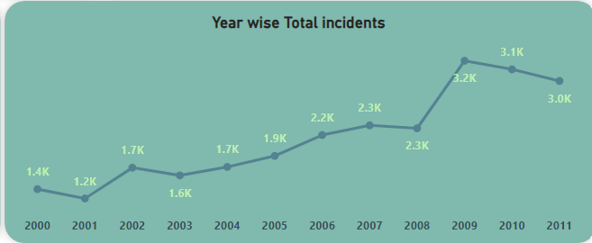
YEAR-WISE ANALYSIS OF BIRD STRIKE INCIDENTS
Early 2000s Stability:
>From 2000 to 2003, the number of incidents remained relatively stable, fluctuating between 1,200 and 1,700 incidents per year. This period represents the baseline against which future changes are measured.
Mid-2000s Increase:
>A noticeable increase in incidents is observed starting around 2004, with numbers rising to 1,900 in 2005 and further to 2,200 in 2006. This rise may coincide with increased air traffic and better incident reporting.
Peak Years:
>The peak in bird strike incidents occurred around 2009 and 2010, with 3,200 and 3,100 incidents respectively. These years saw the highest recorded incidents, indicating periods of significant risk and possibly the need for enhanced mitigation efforts.
Recent Trends:
>Post-2010, there is a slight decrease, with incidents dropping to 3,000 in 2011. This decrease might reflect the implementation of more effective bird strike prevention strategies.

Slide 9
TOTAL BIRD STRIKE INCIDENTS BY PHASE OF FLIGHT
Approach Phase:
>Highest Number of Incidents: The approach phase accounts for the highest number of bird strike incidents, with approximately 10,000 incidents reported. This phase is critical as aircraft descend and prepare to land, making them more susceptible to bird strikes.
>Landing Roll:
Significant Incidents: Around 5,000 incidents occur during the landing roll phase. As aircraft touch down and roll to a stop, they often encounter birds on or near the runway.
>Take-off Run:
High Risk: The take-off run is another phase with a high number of incidents, totaling around 5,000. During take-off, aircraft are accelerating, and bird strikes can cause significant damage due to the high speeds involved.
>Taxi and Parked:
Ground Operations: Bird strikes also occur during taxiing (4,000 incidents) and when aircraft are parked (1,000 incidents). These incidents highlight the need for effective wildlife management around airport grounds.
>Climb and Descent:
In-flight Risks: Incidents during climb and descent phases are fewer in comparison but still notable, with 4,000 incidents each. These phases involve altitude changes, which can intersect with bird flight paths.

Slide 10
TOTAL BIRD STRIKE INCIDENTS BY PRECIPITATION CONDITIONS
1.Clear Weather:
>Highest Number of Incidents: The majority of bird strike incidents, approximately 23,414, occur under clear weather conditions. Clear skies provide optimal flying conditions for birds, increasing the likelihood of encounters with aircraft.
2. Rain:
>Moderate Incidents: Incidents during rain account for about 1,353 cases. Rain can alter bird flight patterns and visibility, but the incidents are fewer compared to clear conditions.
3. Fog:
>Reduced Visibility: Fog-related incidents total around 475. Fog reduces visibility for both birds and pilots, but the number of incidents remains relatively low.
4. Snow:
>Low Incidents: Snowy conditions result in 89 incidents. Snowfall typically reduces bird activity as they seek shelter, leading to fewer strikes.
Operational Adjustments:
>Adjusting flight schedules and routes based on weather predictions can help mitigate bird strike risks. Pilots should be trained to handle bird strike scenarios under different weather conditions.

Slide 11
TOP 3 ALTITUDE RANGES BY BIRD STRIKE INCIDENTS
Ground Level to 200 Feet:
>Highest Incidents: The majority of bird strikes occur within the 0-200 feet altitude range, with approximately 29,000 incidents. This range typically includes take-off and landing phases, where aircraft are at their lowest altitudes and most vulnerable to bird strikes.
>Wildlife Activity: Birds are more likely to be encountered at lower altitudes due to their natural flight patterns and habitat proximity.
200 to 400 Feet:
>Significant Incidents: This altitude range sees around 10,000 incidents. Aircraft are still relatively low during the initial climb or final approach, increasing the likelihood of bird encounters.
400 to 600 Feet:
>Moderate Incidents: With around 6,000 incidents, this range marks the transition phase as aircraft ascend or descend. Birds can still pose a threat during these maneuvers.
Future Directions:
Advanced Technologies:
>Development and deployment of advanced bird detection and deterrence technologies can significantly reduce the risk of bird strikes at lower altitudes. Continue research into bird behavior and flight patterns can inform better mitigation strategies and improve safety protocols.

Slide 12
Top 3 AIRCRAFT MODELS BY COST DUE TO BIRD STRIKES
LEARJET 60:
Over the past decade, bird strikes have resulted in substantial costs totaling $14 million for the Learjet 60. Despite its smaller size compared to commercial jets, the impact of bird strikes underscores the importance of wildlife management around airports and flight paths.
>Number of Engines : 2
B-767-300:
The Boeing 767-300, a workhorse of many airlines, has faced significant financial impacts from bird strikes, amounting to $12 million over the last 10 years. This highlights the need for robust aircraft design and airport procedures to mitigate such risks.
>Number of Engines : 2
B-757-200:
With costs totaling $9 million due to bird strikes, the Boeing 757-200 has also felt the economic repercussions of wildlife encounters during flights. Effective strategies for bird strike prevention and management are crucial for maintaining safe and cost-effective operations.
>Number of Engines : 2

Slide 13
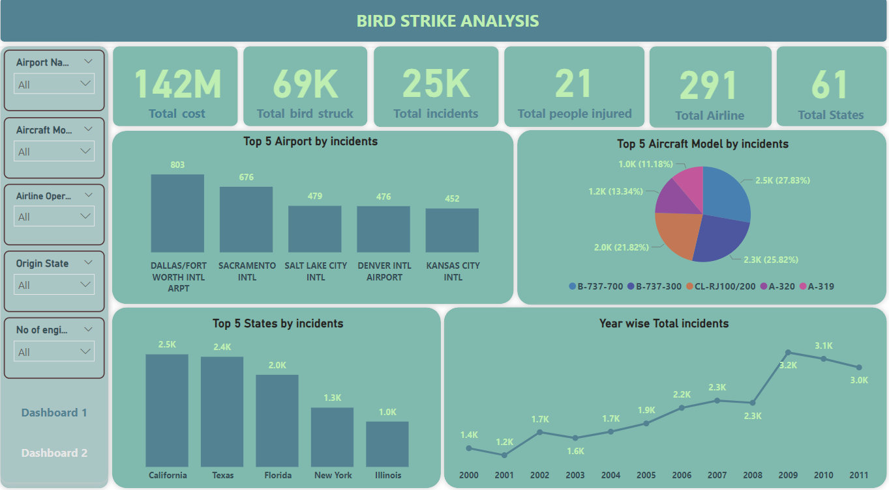
DASHBOARD 1

Slide 14
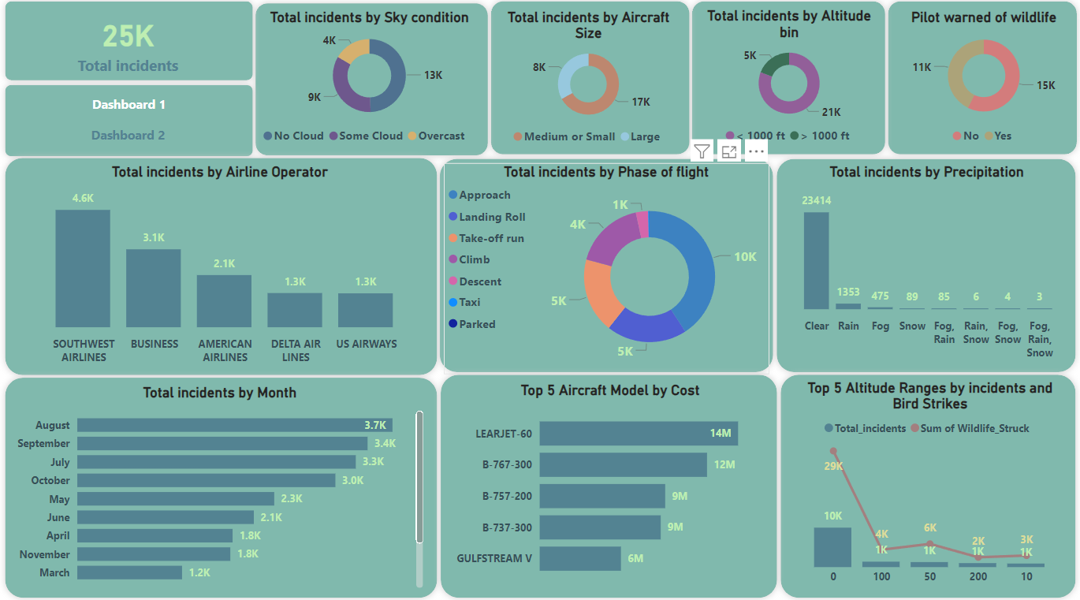
DASHBOARD 2

